Slide 1
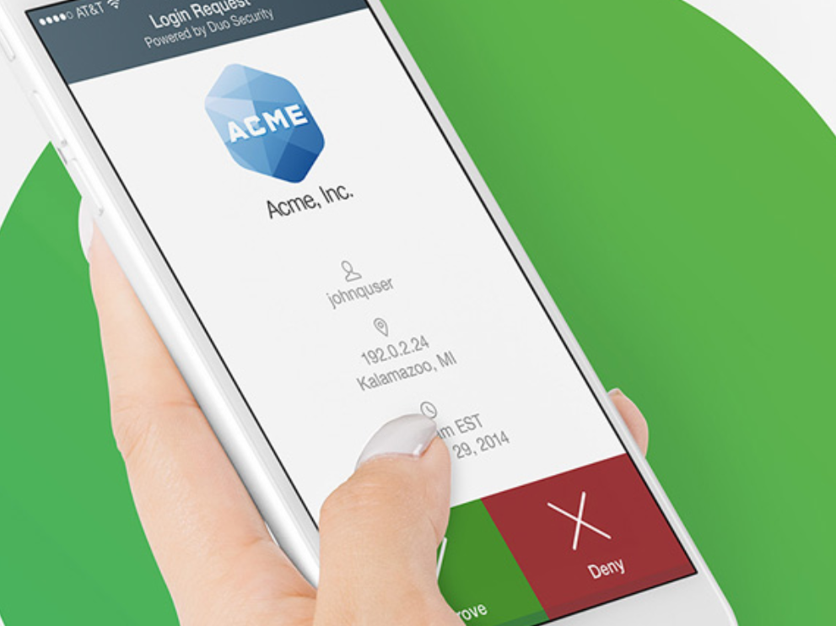
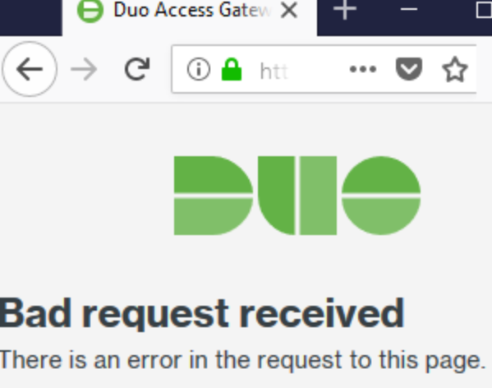
Force Field Analysis – DUO Security in the University
Two Factor Authentication
Driving Force
Restraining Force
An Extra layer of security to validate your identity.
Don’t trust using your phone number or personal device.
Added Infrastructure:
Allows IT to implement new security improved policies.
Potential issues logging in, especially after hours.
Areas of Control
IT can better monitor when someone logs into their network for irregularities.
Growing Industry
Many companies have turned to DUO after having data breaches.
Lack of Control
Potential pushback to adjusting to new technology and change.
Potential Conflict Management
No compensation for personal phone use at work. Cost of a new system.

